Slide 1
Cs1231 T12 tutorial #8
Cardinality

Slide 2
Learning objectives of this tutorial
Cardinality
relationship between bijections and cardinality
Cantor’s definition of same-cardinality
the notion of countability
techniques to show a set is countable
techniques to show a set is uncountable

Slide 3
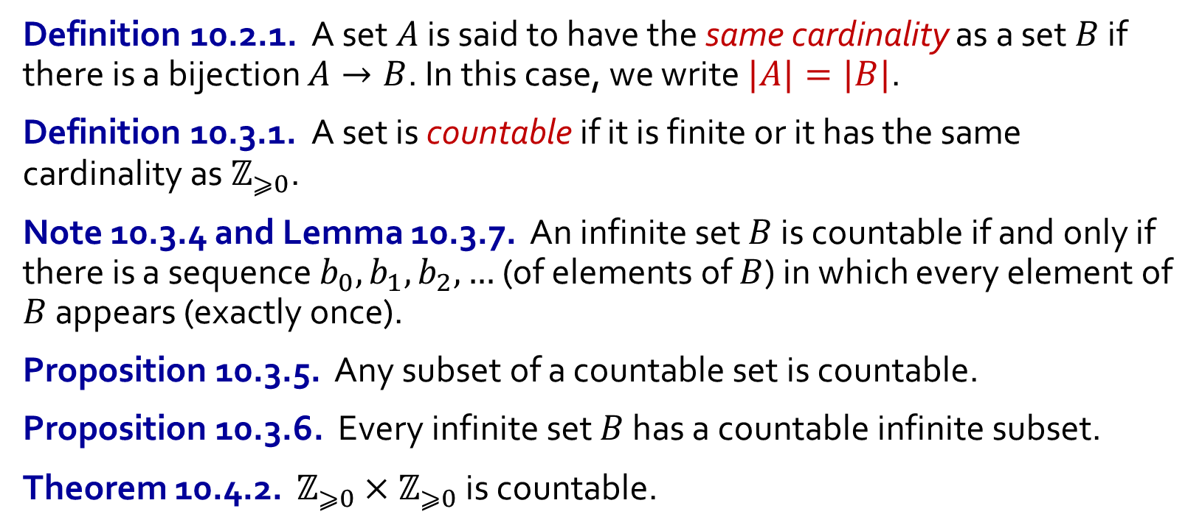
Quick summary
Definition 10.2.1. A set $A$ is said to have the same cardinality as a set $B$ if there is a bijection $A→B$. In this case, we write $|A|=|B|$.
Definition 10.3.1. A set is countable if it is finite or it has the same cardinality as $ℤ_{⩾0}$.
Note 10.3.4 and Lemma 10.3.7. An infinite set $B$ is countable if and only if there is a sequence $b_{0},b_{1},b_{2},…$ (of elements of $B$) in which every element of $B$ appears (exactly once).
Proposition 10.3.5. Any subset of a countable set is countable.
Proposition 10.3.6. Every infinite set $B$ has a countable infinite subset.
Theorem 10.4.2. $ℤ_{⩾0}×ℤ_{⩾0}$ is countable.

Slide 4
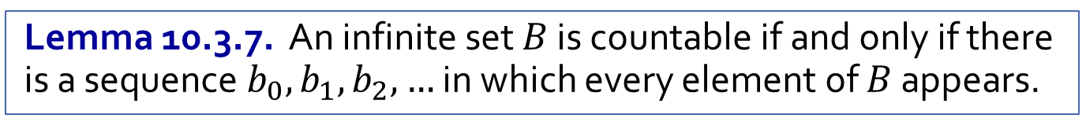
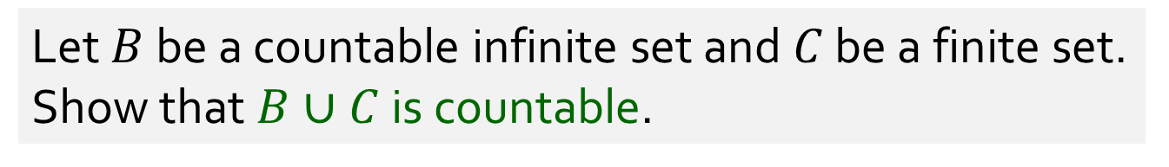
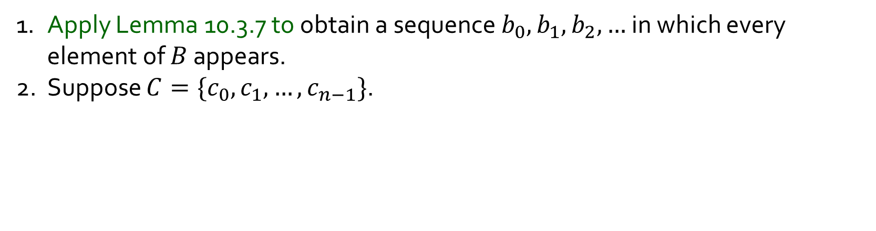
Q1.
Let $B$ be a countable infinite set and $C$ be a finite set. Show that $B∪C$ is countable.
1. Apply Lemma 10.3.7 to obtain a sequence $b_{0},b_{1},b_{2},…$ in which every element of $B$ appears.
2. Suppose $C=\{c_{0},c_{1},…,c_{n−1}\}$.
Lemma 10.3.7. An infinite set $B$ is countable if and only if there is a sequence $b_{0},b_{1},b_{2},…$ in which every element of $B$ appears.

Slide 5
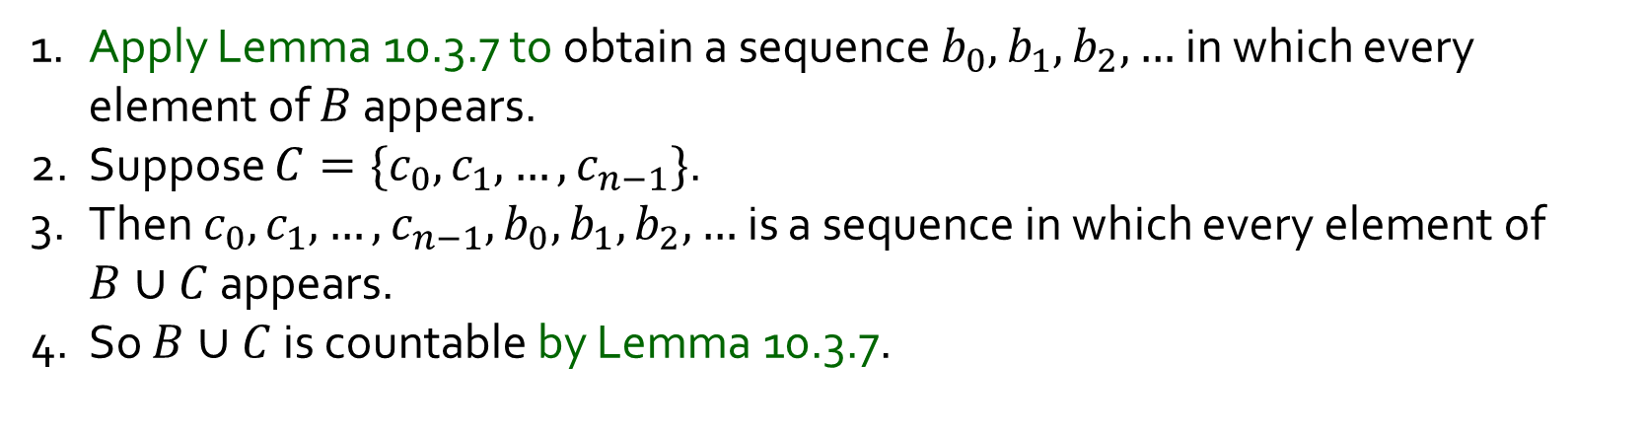
Q1.
Let $B$ be a countable infinite set and $C$ be a finite set. Show that $B∪C$ is countable.
1. Apply Lemma 10.3.7 to obtain a sequence $b_{0},b_{1},b_{2},…$ in which every element of $B$ appears.
2. Suppose $C=\{c_{0},c_{1},…,c_{n−1}\}$.
3. Then $c_{0},c_{1},…,c_{n−1},b_{0},b_{1},b_{2},…$ is a sequence in which every element of $B∪C$ appears.
4. So $B∪C$ is countable by Lemma 10.3.7.
Lemma 10.3.7. An infinite set $B$ is countable if and only if there is a sequence $b_{0},b_{1},b_{2},…$ in which every element of $B$ appears.

Slide 6

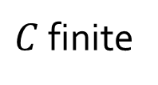
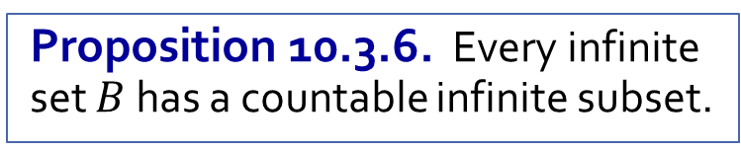

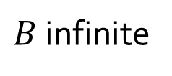
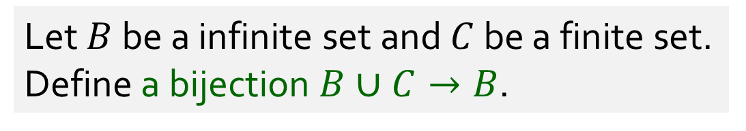
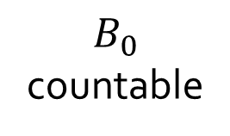


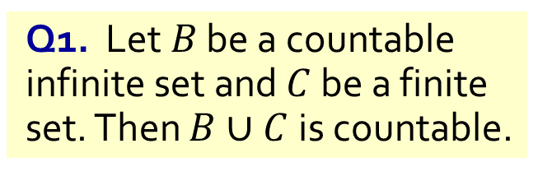

Q2.
Let $B$ be a infinite set and $C$ be a finite set. Define a bijection $B∪C→B$.
Q1. Let $B$ be a countable infinite set and $C$ be a finite set. Then $B∪C$ is countable.
$B$ infinite
$$B$$
$$B_{0}$$
countable
$$B_{0}$$
$C$ finite
$$C_{0}$$
$$C_{0}$$
Proposition 10.3.6. Every infinite set $B$ has a countable infinite subset.

Slide 7
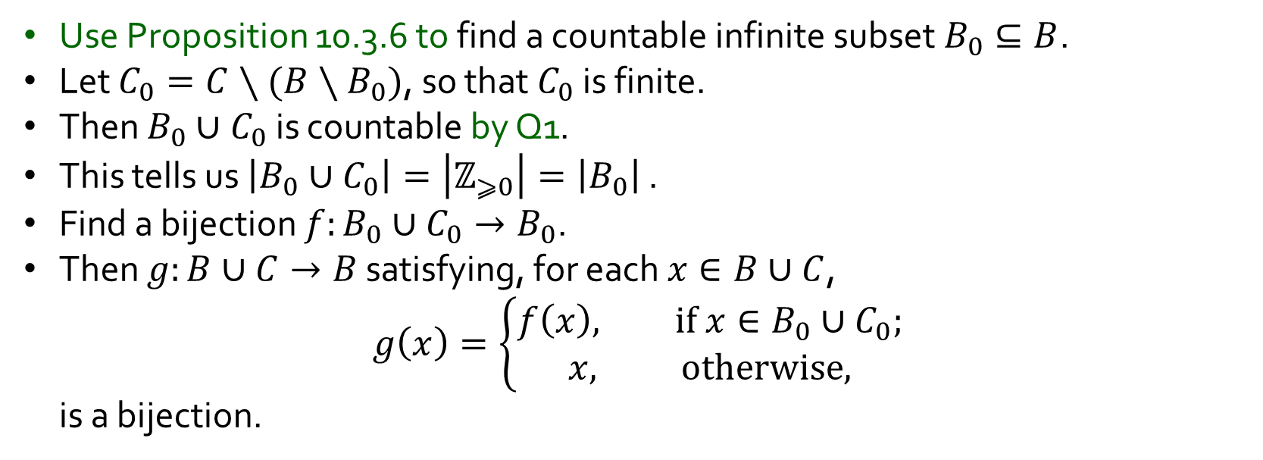
Q2.
Let $B$ be a infinite set and $C$ be a finite set. Define a bijection $B∪C→B$.
Q1. Let $B$ be a countable infinite set and $C$ be a finite set. Then $B∪C$ is countable.
Use Proposition 10.3.6 to find a countable infinite subset $B_{0}⊆B$.
Let $C_{0}=C∖(B∖B_{0})$, so that $C_{0}$ is finite.
Then $B_{0}∪C_{0}$ is countable by Q1.
This tells us $\left|B_{0}∪C_{0}\right|=\left|ℤ_{⩾0}\right|=\left|B_{0}\right|$ .
Find a bijection $f:B_{0}∪C_{0}→B_{0}$.
Then $g:B∪C→B$ satisfying, for each $x∈B∪C$,
$$g\left(x\right)=\left\{\begin{aligned}f\left(x\right), if x∈B_{0}∪C_{0}; \\ &x, otherwise,\end{aligned}\right.$$
is a bijection.
Proposition 10.3.6. Every infinite set $B$ has a countable infinite subset.

Slide 8
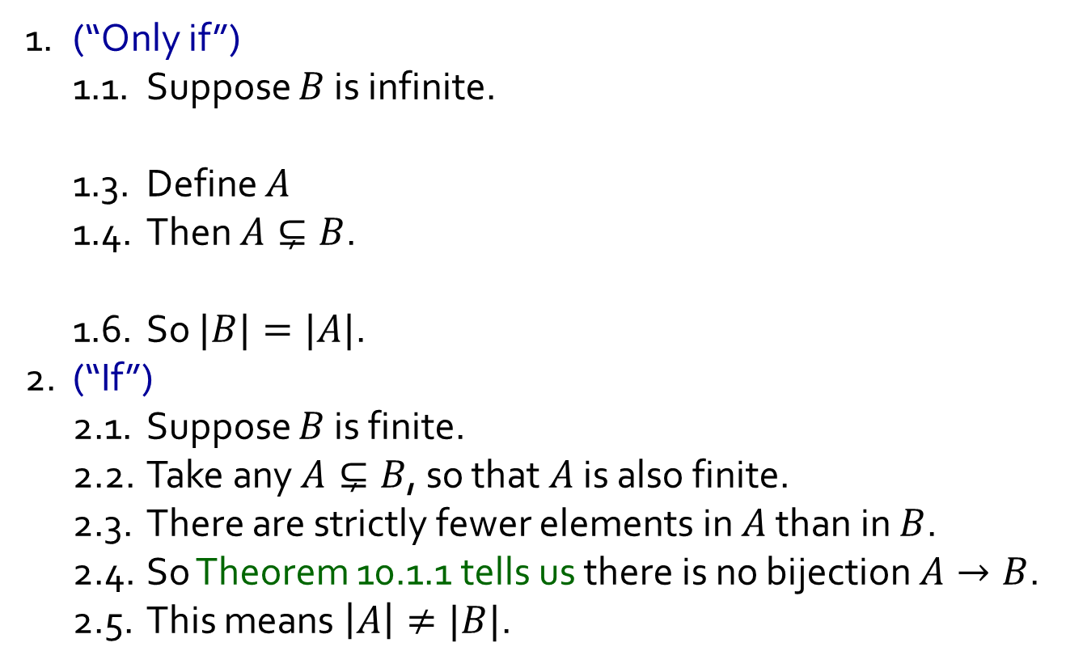
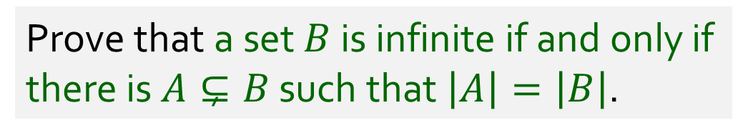
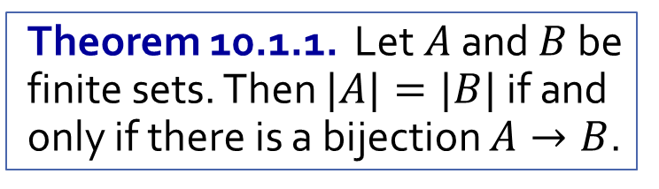
Q3.
Prove that a set $B$ is infinite if and only if there is $A⊊B$ such that $\left|A\right|=\left|B\right|$.
1. (“Only if”)
1.1. Suppose $B$ is infinite.
1.2. Take any $b∈B$.
1.3. Define $A=B∖\{b\}$.
1.4. Then $A⊊B$.
1.5. As $B$ is infinite, we know $A$ is infinite too.
1.6. So $|B|=|A|$.
2. (“If”)
2.1. Suppose $B$ is finite.
2.2. Take any $A⊊B$, so that $A$ is also finite.
2.3. There are strictly fewer elements in $A$ than in $B$.
2.4. So Theorem 10.1.1 tells us there is no bijection $A→B$.
2.5. This means $\left|A\right|≠|B|$.
Theorem 10.1.1. Let $A$ and $B$ be finite sets. Then $|A|=|B|$ if and only if there is a bijection $A→B$.

Slide 9
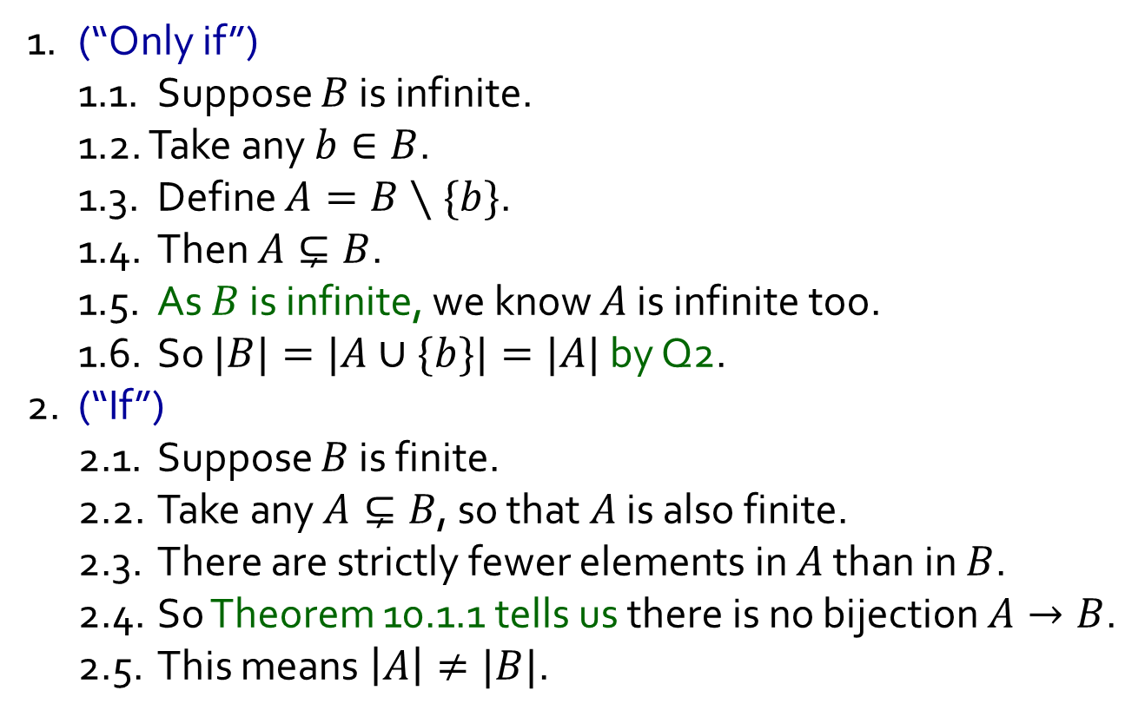
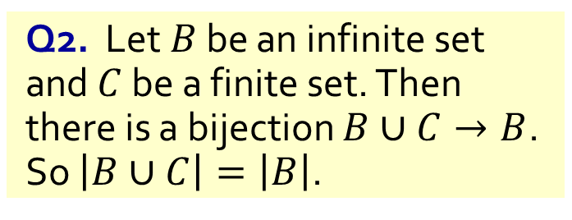
Q3.
Prove that a set $B$ is infinite if and only if there is $A⊊B$ such that $\left|A\right|=\left|B\right|$.
Q2. Let $B$ be an infinite set and $C$ be a finite set. Then there is a bijection $B∪C→B$. So $\left|B∪C\right|=\left|B\right|$.
1. (“Only if”)
1.1. Suppose $B$ is infinite.
1.2. Take any $b∈B$.
1.3. Define $A=B∖\{b\}$.
1.4. Then $A⊊B$.
1.5. As $B$ is infinite, we know $A$ is infinite too.
1.6. So $|B|=|A∪\{b\}|=|A|$ by Q2.
2. (“If”)
2.1. Suppose $B$ is finite.
2.2. Take any $A⊊B$, so that $A$ is also finite.
2.3. There are strictly fewer elements in $A$ than in $B$.
2.4. So Theorem 10.1.1 tells us there is no bijection $A→B$.
2.5. This means $\left|A\right|≠|B|$.
Theorem 10.1.1. Let $A$ and $B$ be finite sets. Then $|A|=|B|$ if and only if there is a bijection $A→B$.

Slide 10
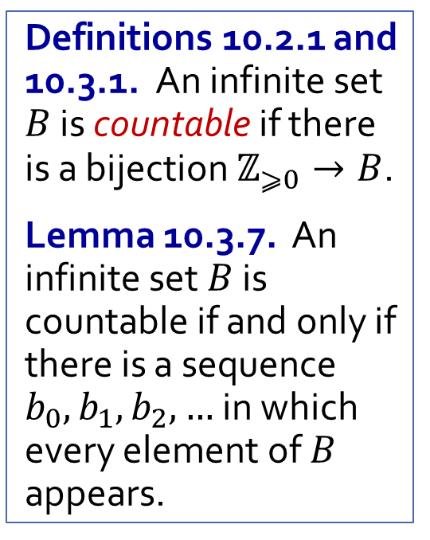
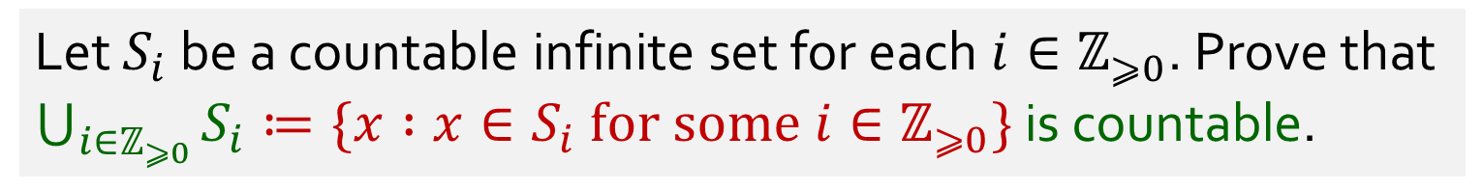
Q4.
Let $S_{i}$ be a countable infinite set for each $i∈ℤ_{⩾0}$. Prove that $\bigcup_{i∈ℤ_{⩾0}}{S_{i}}≔\{x :x∈S_{i} for some i∈ℤ_{⩾0}\}$ is countable.
Definitions 10.2.1 and 10.3.1. An infinite set $B$ is countable if there is a bijection $ℤ_{⩾0}→B$.
Lemma 10.3.7. An infinite set $B$ is countable if and only if there is a sequence $b_{0},b_{1},b_{2},…$ in which every element of $B$ appears.

Slide 11
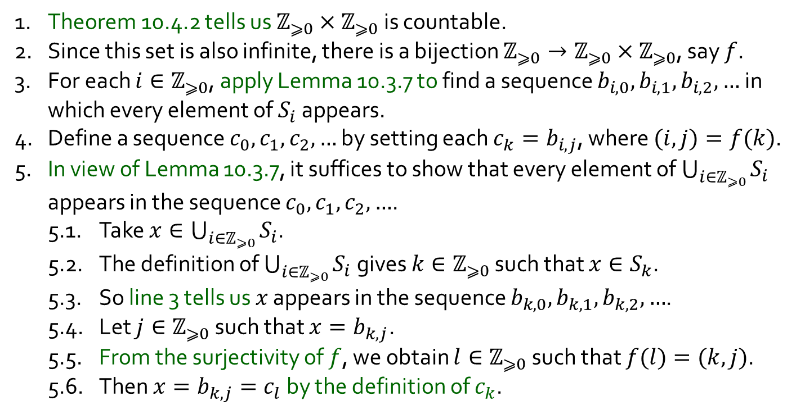
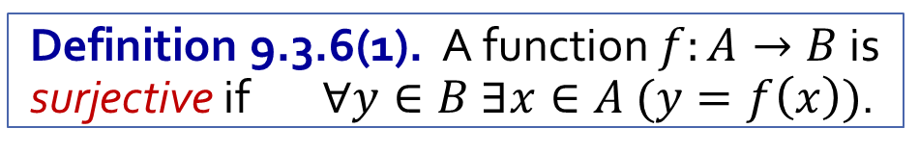

Q4.
Let $S_{i}$ be a countable infinite set for each $i∈ℤ_{⩾0}$. Prove that $\bigcup_{i∈ℤ_{⩾0}}{S_{i}}≔\{x :x∈S_{i} for some i∈ℤ_{⩾0}\}$ is countable.
1. Theorem 10.4.2 tells us $ℤ_{⩾0}×ℤ_{⩾0}$ is countable.
2. Since this set is also infinite, there is a bijection $ℤ_{⩾0}→ℤ_{⩾0}×ℤ_{⩾0}$, say $f$.
3. For each $i∈ℤ_{⩾0}$, apply Lemma 10.3.7 to find a sequence $b_{i,0}, b_{i,1}, b_{i,2}, …$ in which every element of $S_{i}$ appears.
4. Define a sequence $c_{0},c_{1},c_{2},…$ by setting each $c_{k}=b_{i,j}$, where $(i, j)=f(k)$.
5. In view of Lemma 10.3.7, it suffices to show that every element of $\bigcup_{i∈ℤ_{⩾0}}{S_{i}}$ appears in the sequence $c_{0},c_{1},c_{2},…$.
5.1. Take $x∈\bigcup_{i∈ℤ_{⩾0}}{S_{i}}$.
5.2. The definition of $\bigcup_{i∈ℤ_{⩾0}}{S_{i}}$ gives $k∈ℤ_{⩾0}$ such that $x∈S_{k}$.
5.3. So line 3 tells us $x$ appears in the sequence $b_{k,0}, b_{k,1}, b_{k,2}, …$.
5.4. Let $j∈ℤ_{⩾0}$ such that $x=b_{k,j}$.
5.5. From the surjectivity of $f$, we obtain $l∈ℤ_{⩾0}$ such that $f(l)=(k, j)$.
5.6. Then $x=b_{k,j}=c_{l}$ by the definition of $c_{k}$.
Definitions 10.2.1 and 10.3.1. An infinite set $B$ is countable if there is a bijection $ℤ_{⩾0}→B$.
Lemma 10.3.7. An infinite set $B$ is countable if and only if there is a sequence $b_{0},b_{1},b_{2},…$ in which every element of $B$ appears.
Definition 9.3.6(1). A function $f:A→B$ is surjective if $∀y∈B ∃x∈A (y=f\left(x\right))$.
Theorem 10.4.2. $ℤ_{⩾0}×ℤ_{⩾0}$ is countable.

Slide 12
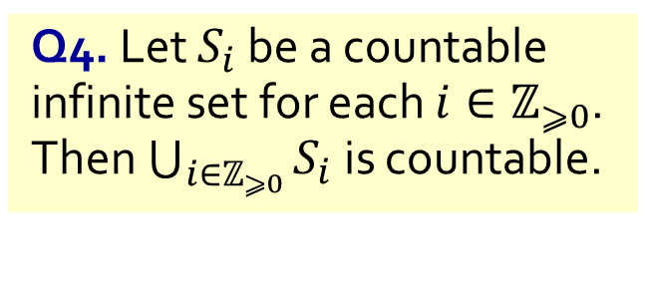
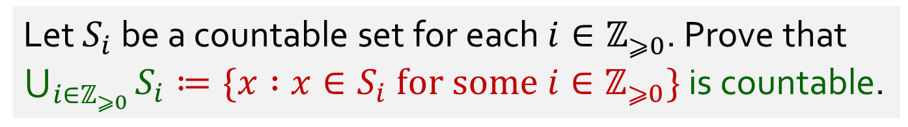
Q5.
Let $S_{i}$ be a countable set for each $i∈ℤ_{⩾0}$. Prove that $\bigcup_{i∈ℤ_{⩾0}}{S_{i}}≔\{x :x∈S_{i} for some i∈ℤ_{⩾0}\}$ is countable.
Q4. Let $S_{i}$ be a countable infinite set for each $i∈ℤ_{⩾0}$. Then $\bigcup_{i∈ℤ_{⩾0}}{S_{i}}$ is countable.

Slide 13
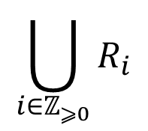




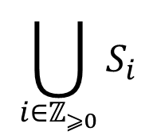









Q5.
Let $S_{i}$ be a countable set for each $i∈ℤ_{⩾0}$. Prove that $\bigcup_{i∈ℤ_{⩾0}}{S_{i}}≔\{x :x∈S_{i} for some i∈ℤ_{⩾0}\}$ is countable.
countable
countable
infinite
$$S_{0}$$
$$⊆$$
$$R_{0}$$
$$S_{1}$$
$$⊆$$
$$R_{1}$$
$$S_{2}$$
$$⊆$$
$$R_{2}$$
Q4. Let $S_{i}$ be a countable infinite set for each $i∈ℤ_{⩾0}$. Then $\bigcup_{i∈ℤ_{⩾0}}{S_{i}}$ is countable.
$$⋮$$
$$⋮$$
$$⋮$$
$$\bigcup_{i∈ℤ_{⩾0}}{S_{i}}$$
$$\bigcup_{i∈ℤ_{⩾0}}{R_{i}}$$
$$⊆$$
Proposition 10.3.5. Any subset of a countable set is countable.

Slide 14
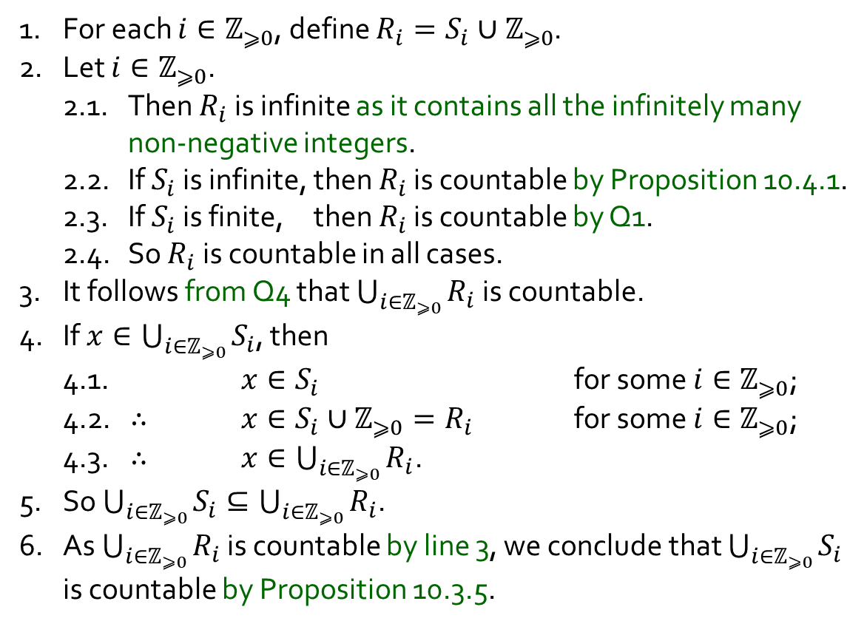
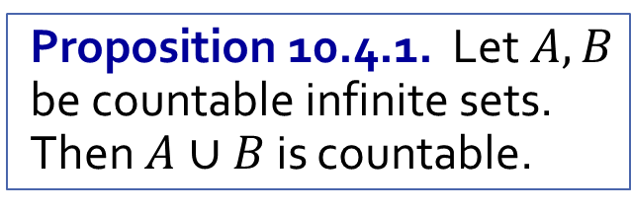
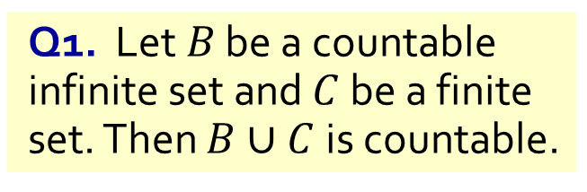
Q5.
Let $S_{i}$ be a countable set for each $i∈ℤ_{⩾0}$. Prove that $\bigcup_{i∈ℤ_{⩾0}}{S_{i}}≔\{x :x∈S_{i} for some i∈ℤ_{⩾0}\}$ is countable.
1. For each $i∈ℤ_{⩾0}$, define $R_{i}=S_{i}∪ℤ_{⩾0}$.
2. Let $i∈ℤ_{⩾0}$.
2.1. Then $R_{i}$ is infinite as it contains all the infinitely many non-negative integers.
2.2. If $S_{i}$ is infinite, then $R_{i}$ is countable by Proposition 10.4.1.
2.3. If $S_{i}$ is finite, then $R_{i}$ is countable by Q1.
2.4. So $R_{i}$ is countable in all cases.
3. It follows from Q4 that $\bigcup_{i∈ℤ_{⩾0}}{R_{i}}$ is countable.
4. If $x∈\bigcup_{i∈ℤ_{⩾0}}{S_{i}}$, then
4.1. $x∈S_{i}$ for some $i∈ℤ_{⩾0}$;
4.2. ∴ $x∈S_{i}∪ℤ_{⩾0}=R_{i}$ for some $i∈ℤ_{⩾0}$;
4.3. ∴ $x∈\bigcup_{i∈ℤ_{⩾0}}{R_{i}}$.
5. So $\bigcup_{i∈ℤ_{⩾0}}{S_{i}}⊆\bigcup_{i∈ℤ_{⩾0}}{R_{i}}$.
6. As $\bigcup_{i∈ℤ_{⩾0}}{R_{i}}$ is countable by line 3, we conclude that $\bigcup_{i∈ℤ_{⩾0}}{S_{i}}$ is countable by Proposition 10.3.5.
Proposition 10.4.1. Let $A,B$ be countable infinite sets. Then $A∪B$ is countable.
Q1. Let $B$ be a countable infinite set and $C$ be a finite set. Then $B∪C$ is countable.
Q4. Let $S_{i}$ be a countable infinite set for each $i∈ℤ_{⩾0}$. Then $\bigcup_{i∈ℤ_{⩾0}}{S_{i}}$ is countable.
Proposition 10.3.5. Any subset of a countable set is countable.

Slide 15
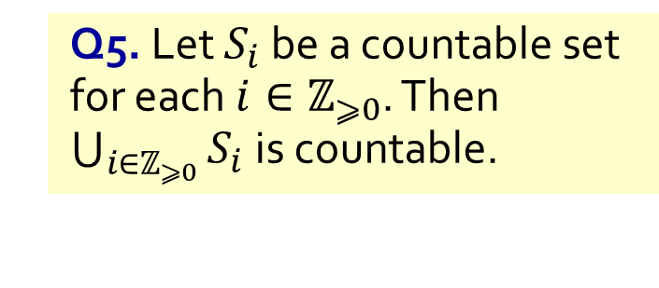
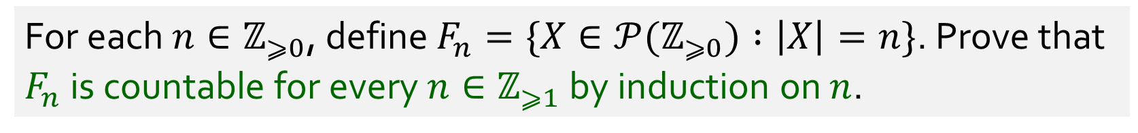
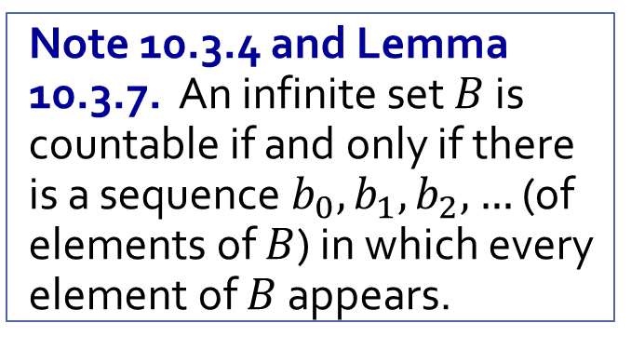
Q6(a).
For each $n∈ℤ_{⩾0}$, define $F_{n}=\{X∈𝒫(ℤ_{⩾0}) :\left|X\right|=n\}$. Prove that $F_{n}$ is countable for every $n∈ℤ_{⩾1}$ by induction on $n$.
Note 10.3.4 and Lemma 10.3.7. An infinite set $B$ is countable if and only if there is a sequence $b_{0},b_{1},b_{2},…$ (of elements of $B$) in which every element of $B$ appears.
Q5. Let $S_{i}$ be a countable set for each $i∈ℤ_{⩾0}$. Then $\bigcup_{i∈ℤ_{⩾0}}{S_{i}}$ is countable.
Proposition 10.3.5. Any subset of a countable set is countable.

Slide 16
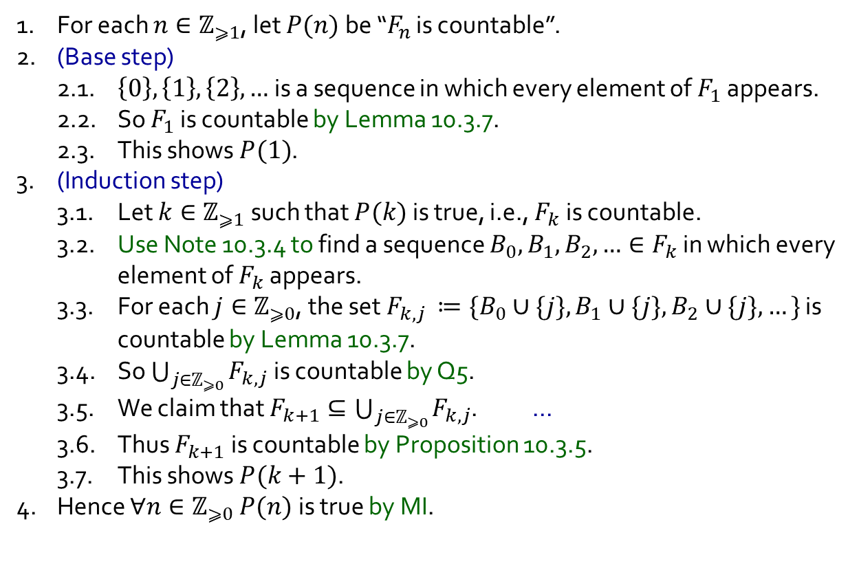
Q6(a).
For each $n∈ℤ_{⩾0}$, define $F_{n}=\{X∈𝒫(ℤ_{⩾0}) :\left|X\right|=n\}$. Prove that $F_{n}$ is countable for every $n∈ℤ_{⩾1}$ by induction on $n$.
1. For each $n∈ℤ_{⩾1}$, let $P(n)$ be “$F_{n}$ is countable”.
2. (Base step)
2.1. $\left\{0\right\}, \left\{1\right\}, \left\{2\right\},…$ is a sequence in which every element of $F_{1}$ appears.
2.2. So $F_{1}$ is countable by Lemma 10.3.7.
2.3. This shows $P(1)$.
3. (Induction step)
3.1. Let $k∈ℤ_{⩾1}$ such that $P(k)$ is true, i.e., $F_{k}$ is countable.
3.2. Use Note 10.3.4 to find a sequence $B_{0},B_{1},B_{2},…∈F_{k}$ in which every element of $F_{k}$ appears.
3.3. For each $j∈ℤ_{⩾0}$, the set $F_{k,j }≔\{B_{0}∪\{j\}, B_{1}∪\{j\}, B_{2}∪\{j\}, …\}$ is countable by Lemma 10.3.7.
3.4. So $\bigcup_{j∈ℤ_{⩾0}}{F_{k,j}}$ is countable by Q5.
3.5. We claim that $F_{k+1}⊆\bigcup_{j∈ℤ_{⩾0}}{F_{k,j}}$. …
3.6. Thus $F_{k+1}$ is countable by Proposition 10.3.5.
3.7. This shows $P(k+1)$.
4. Hence $∀n∈ℤ_{⩾0} P(n)$ is true by MI.
Note 10.3.4 and Lemma 10.3.7. An infinite set $B$ is countable if and only if there is a sequence $b_{0},b_{1},b_{2},…$ (of elements of $B$) in which every element of $B$ appears.
Q5. Let $S_{i}$ be a countable set for each $i∈ℤ_{⩾0}$. Then $\bigcup_{i∈ℤ_{⩾0}}{S_{i}}$ is countable.
Proposition 10.3.5. Any subset of a countable set is countable.

Slide 17
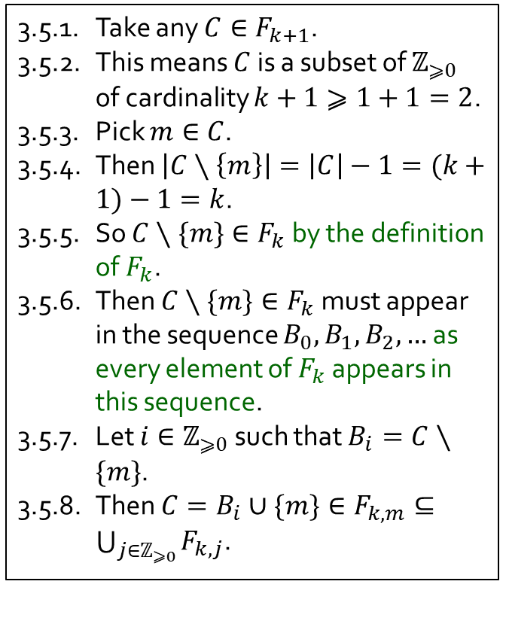
Q6(a).
For each $n∈ℤ_{⩾0}$, define $F_{n}=\{X∈𝒫(ℤ_{⩾0}) :\left|X\right|=n\}$. Prove that $F_{n}$ is countable for every $n∈ℤ_{⩾1}$ by induction on $n$.
1. For each $n∈ℤ_{⩾1}$, let $P(n)$ be “$F_{n}$ is countable”.
2. (Base step)
2.1. $\left\{0\right\}, \left\{1\right\}, \left\{2\right\},…$ is a sequence in which every element of $F_{1}$ appears.
2.2. So $F_{1}$ is countable by Lemma 10.3.7.
2.3. This shows $P(1)$.
3. (Induction step)
3.1. Let $k∈ℤ_{⩾1}$ such that $P(k)$ is true, i.e., $F_{k}$ is countable.
3.2. Use Note 10.3.4 to find a sequence $B_{0},B_{1},B_{2},…∈F_{k}$ in which every element of $F_{k}$ appears.
3.3. For each $j∈ℤ_{⩾0}$, the set $F_{k,j }≔\{B_{0}∪\{j\}, B_{1}∪\{j\}, B_{2}∪\{j\}, …\}$ is countable by Lemma 10.3.7.
3.4. So $\bigcup_{j∈ℤ_{⩾0}}{F_{k,j}}$ is countable by Q5.
3.5. We claim that $F_{k+1}⊆\bigcup_{j∈ℤ_{⩾0}}{F_{k,j}}$. …
3.6. Thus $F_{k+1}$ is countable by Proposition 10.3.5.
3.7. This shows $P(k+1)$.
4. Hence $∀n∈ℤ_{⩾0} P(n)$ is true by MI.
3.5.1. Take any $C∈F_{k+1}$.
3.5.2. This means $C$ is a subset of $ℤ_{⩾0}$ of cardinality $k+1⩾1+1=2$.
3.5.3. Pick $m∈C$.
3.5.4. Then $\left|C∖\left\{m\right\}\right|=\left|C\right|−1=(k+1)−1=k$.
3.5.5. So $C∖\{m\}∈F_{k}$ by the definition of $F_{k}$.
3.5.6. Then $C∖\{m\}∈F_{k}$ must appear in the sequence $B_{0}, B_{1}, B_{2},…$ as every element of $F_{k}$ appears in this sequence.
3.5.7. Let $i∈ℤ_{⩾0}$ such that $B_{i}=C∖\{m\}$.
3.5.8. Then $C=B_{i}∪\{m\}∈F_{k,m}⊆\bigcup_{j∈ℤ_{⩾0}}{F_{k,j}}$.

Slide 18
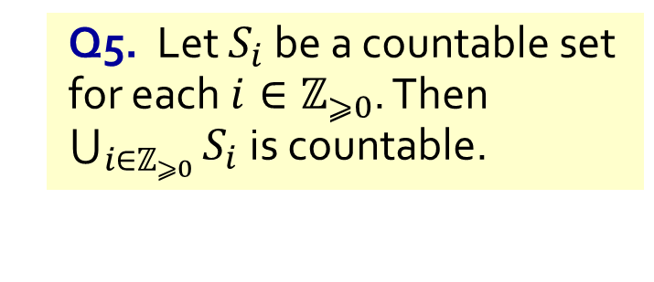
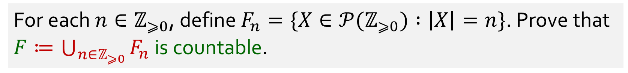
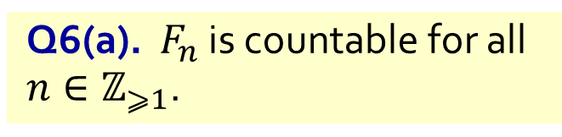
Q6(b).
For each $n∈ℤ_{⩾0}$, define $F_{n}=\{X∈𝒫(ℤ_{⩾0}) :\left|X\right|=n\}$. Prove that $F≔\bigcup_{n∈ℤ_{⩾0}}{F_{n}}$ is countable.
Q6(a). $F_{n}$ is countable for all $n∈ℤ_{⩾1}$.
Q5. Let $S_{i}$ be a countable set for each $i∈ℤ_{⩾0}$. Then $\bigcup_{i∈ℤ_{⩾0}}{S_{i}}$ is countable.

Slide 19
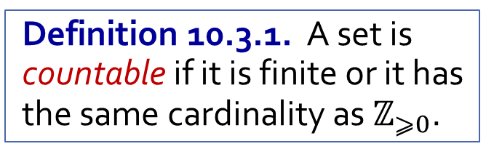

Q6(b).
For each $n∈ℤ_{⩾0}$, define $F_{n}=\{X∈𝒫(ℤ_{⩾0}) :\left|X\right|=n\}$. Prove that $F≔\bigcup_{n∈ℤ_{⩾0}}{F_{n}}$ is countable.
1. Note that $F_{0}=\{X∈𝒫(ℤ_{⩾0}) :\left|X\right|=0\}=\{∅\}$.
2. So $F_{0}$ is finite and hence countable.
3. It follows from (a) that $F_{n}$ is countable for all $n∈ℤ_{⩾0}$.
4. Hence $F$ is countable by Q5.
Q6(a). $F_{n}$ is countable for all $n∈ℤ_{⩾1}$.
Q5. Let $S_{i}$ be a countable set for each $i∈ℤ_{⩾0}$. Then $\bigcup_{i∈ℤ_{⩾0}}{S_{i}}$ is countable.
Definition 10.3.1. A set is countable if it is finite or it has the same cardinality as $ℤ_{⩾0}$.

Slide 20


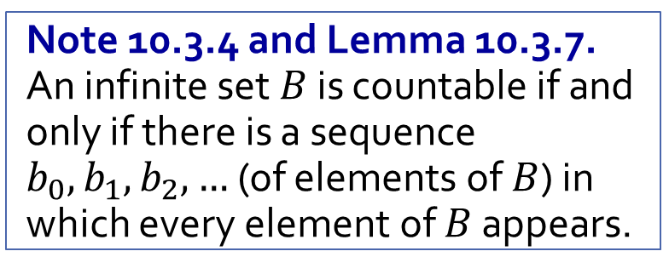
Q7.
Show that $ℚ$ is countable.
Exercise 10.4.4. $ℚ_{⩾0}$ is countable.
Note 10.3.4 and Lemma 10.3.7. An infinite set $B$ is countable if and only if there is a sequence $b_{0},b_{1},b_{2},…$ (of elements of $B$) in which every element of $B$ appears.

Slide 21
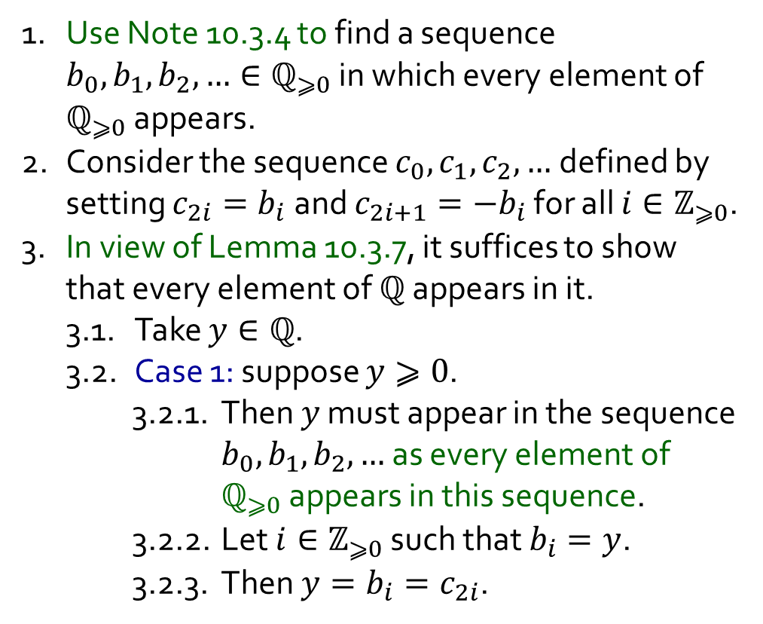
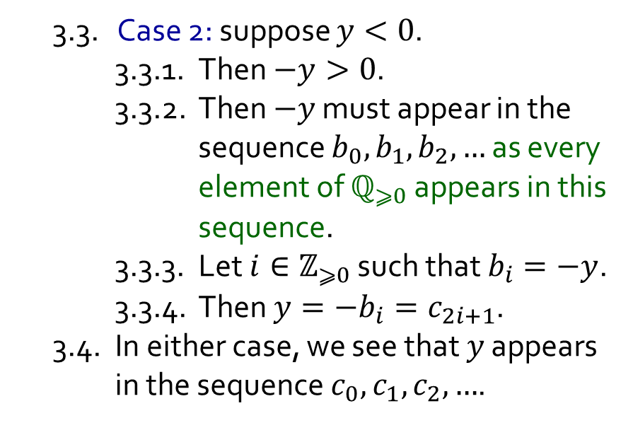
Q7.
Show that $ℚ$ is countable.
Exercise 10.4.4. $ℚ_{⩾0}$ is countable.
Note 10.3.4 and Lemma 10.3.7. An infinite set $B$ is countable if and only if there is a sequence $b_{0},b_{1},b_{2},…$ (of elements of $B$) in which every element of $B$ appears.
1. Use Note 10.3.4 to find a sequence $b_{0}, b_{1}, b_{2},…∈ℚ_{⩾0}$ in which every element of $ℚ_{⩾0}$ appears.
2. Consider the sequence $c_{0},c_{1},c_{2},…$ defined by setting $c_{2i}=b_{i}$ and $c_{2i+1}=−b_{i}$ for all $i∈ℤ_{⩾0}$.
3. In view of Lemma 10.3.7, it suffices to show that every element of $ℚ$ appears in it.
3.1. Take $y∈ℚ$.
3.2. Case 1: suppose $y⩾0$.
3.2.1. Then $y$ must appear in the sequence $b_{0}, b_{1}, b_{2},…$ as every element of $ℚ_{⩾0}$ appears in this sequence.
3.2.2. Let $i∈ℤ_{⩾0}$ such that $b_{i}=y$.
3.2.3. Then $y=b_{i}=c_{2i}$.
3.3. Case 2: suppose $y<0$.
3.3.1. Then $−y>0$.
3.3.2. Then $−y$ must appear in the sequence $b_{0}, b_{1}, b_{2},…$ as every element of $ℚ_{⩾0}$ appears in this sequence.
3.3.3. Let $i∈ℤ_{⩾0}$ such that $b_{i}=−y$.
3.3.4. Then $y=−b_{i}=c_{2i+1}$.
3.4. In either case, we see that $y$ appears in the sequence $c_{0}, c_{1}, c_{2},…$.

Slide 22
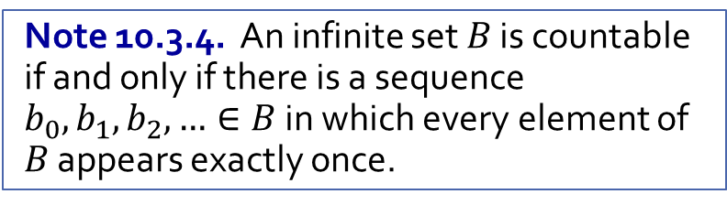
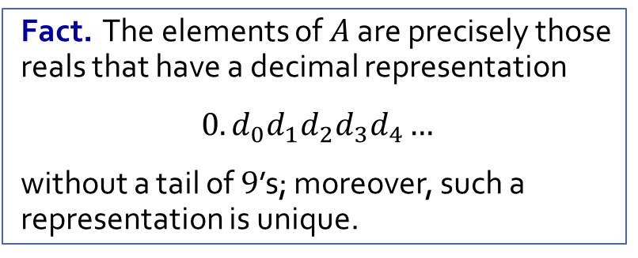
Q8.
Let $A=\{x∈ℝ :0⩽x<1\}$. Prove that $A$ is uncountable.
Fact. The elements of $A$ are precisely those reals that have a decimal representation
$0.d_{0}d_{1}d_{2}d_{3}d_{4}…$
without a tail of $9$’s; moreover, such a representation is unique.
Note 10.3.4. An infinite set $B$ is countable if and only if there is a sequence $b_{0},b_{1},b_{2},…∈B$ in which every element of $B$ appears exactly once.

Slide 23
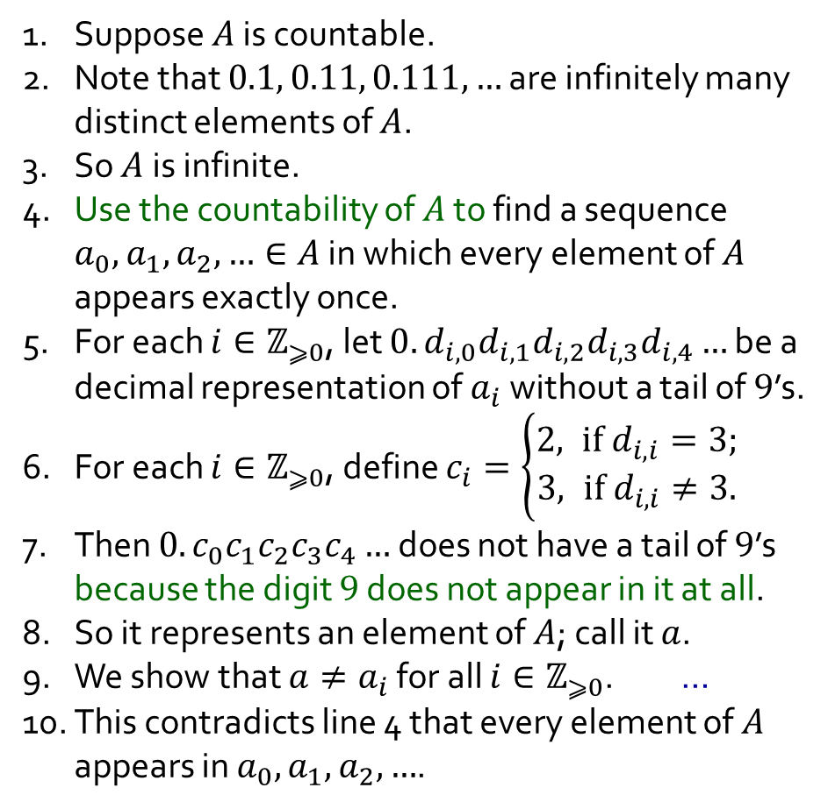
Q8.
Let $A=\{x∈ℝ :0⩽x<1\}$. Prove that $A$ is uncountable.
1. Suppose $A$ is countable.
2. Note that $0.1, 0.11, 0.111,…$ are infinitely many distinct elements of $A$.
3. So $A$ is infinite.
4. Use the countability of $A$ to find a sequence $a_{0}, a_{1}, a_{2}, …∈A$ in which every element of $A$ appears exactly once.
5. For each $i∈ℤ_{⩾0}$, let $0.d_{i,0}d_{i,1}d_{i,2}d_{i,3}d_{i,4}…$ be a decimal representation of $a_{i}$ without a tail of $9$’s.
6. For each $i∈ℤ_{⩾0}$, define $c_{i}=\left\{\begin{aligned}2, if d_{i,i}=3; \\ &3, if d_{i,i}≠3.\end{aligned}\right.$
7. Then $0.c_{0}c_{1}c_{2}c_{3}c_{4}…$ does not have a tail of $9$’s because the digit $9$ does not appear in it at all.
8. So it represents an element of $A$; call it $a$.
9. We show that $a≠a_{i}$ for all $i∈ℤ_{⩾0}$. …
10. This contradicts line 4 that every element of $A$ appears in $a_{0}, a_{1}, a_{2},…$.
Fact. The elements of $A$ are precisely those reals that have a decimal representation
$0.d_{0}d_{1}d_{2}d_{3}d_{4}…$
without a tail of $9$’s; moreover, such a representation is unique.
Note 10.3.4. An infinite set $B$ is countable if and only if there is a sequence $b_{0},b_{1},b_{2},…∈B$ in which every element of $B$ appears exactly once.

Slide 24
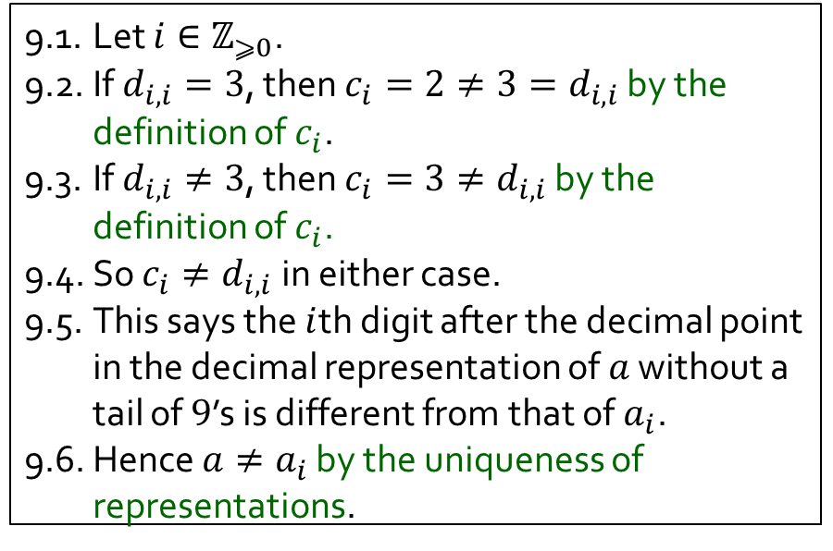
Q8.
Let $A=\{x∈ℝ :0⩽x<1\}$. Prove that $A$ is uncountable.
1. Suppose $A$ is countable.
2. Note that $0.1, 0.11, 0.111,…$ are infinitely many distinct elements of $A$.
3. So $A$ is infinite.
4. Use the countability of $A$ to find a sequence $a_{0}, a_{1}, a_{2}, …∈A$ in which every element of $A$ appears exactly once.
5. For each $i∈ℤ_{⩾0}$, let $0.d_{i,0}d_{i,1}d_{i,2}d_{i,3}d_{i,4}…$ be a decimal representation of $a_{i}$ without a tail of $9$’s.
6. For each $i∈ℤ_{⩾0}$, define $c_{i}=\left\{\begin{aligned}2, if d_{i,i}=3; \\ &3, if d_{i,i}≠3.\end{aligned}\right.$
7. Then $0.c_{0}c_{1}c_{2}c_{3}c_{4}…$ does not have a tail of $9$’s because the digit $9$ does not appear in it at all.
8. So it represents an element of $A$; call it $a$.
9. We show that $a≠a_{i}$ for all $i∈ℤ_{⩾0}$. …
10. This contradicts line 4 that every element of $A$ appears in $a_{0}, a_{1}, a_{2},…$.
Fact. The elements of $A$ are precisely those reals that have a decimal representation
$0.d_{0}d_{1}d_{2}d_{3}d_{4}…$
without a tail of $9$’s; moreover, such a representation is unique.
9.1. Let $i∈ℤ_{⩾0}$.
9.2. If $d_{i,i}=3$, then $c_{i}=2≠3=d_{i,i}$ by the definition of $c_{i}$.
9.3. If $d_{i,i}≠3$, then $c_{i}=3≠d_{i,i}$ by the definition of $c_{i}$.
9.4. So $c_{i}≠d_{i,i}$ in either case.
9.5. This says the $i$th digit after the decimal point in the decimal representation of $a$ without a tail of $9$’s is different from that of $a_{i}$.
9.6. Hence $a≠a_{i}$ by the uniqueness of representations.

Slide 25
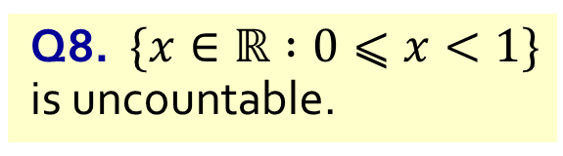

Q9.
Prove that $ℝ$ and $ℂ$ are uncountable.
Q8. $\{x∈ℝ :0⩽x<1\}$ is uncountable.
Proposition 10.3.5. Any subset of a countable set is countable.

Slide 26
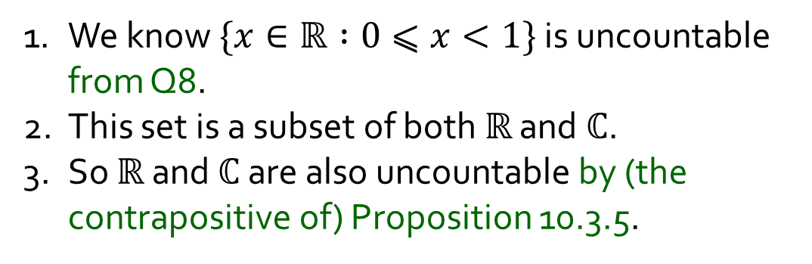
Q9.
Prove that $ℝ$ and $ℂ$ are uncountable.
Q8. $\{x∈ℝ :0⩽x<1\}$ is uncountable.
Proposition 10.3.5. Any subset of a countable set is countable.
1. We know $\{x∈ℝ :0⩽x<1\}$ is uncountable from Q8.
2. This set is a subset of both $ℝ$ and $ℂ$.
3. So $ℝ$ and $ℂ$ are also uncountable by (the contrapositive of) Proposition 10.3.5.

